Slide 1


Implementing Transform
BOM filters

Slide 2
Goal
Understanding Transform contract
_flush
Stream state
Releasing resources
Basic usage of Buffer API
Buffer.from
Buf.equals

Slide 3
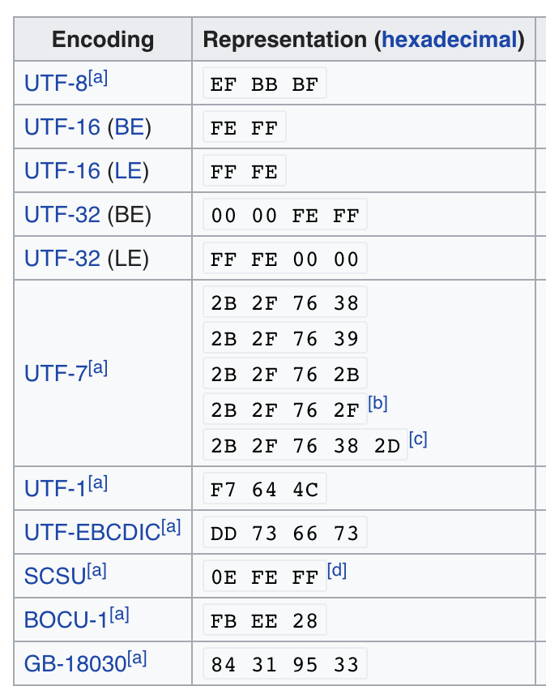
BOM - byte order mark (BOM)
https://en.wikipedia.org/wiki/Byte_order_mark
The byte order mark (BOM) is a Unicode character, U+FEFF BYTE ORDER MARK (BOM), whose appearance as a magic number at the start of a text stream can signal several things to a program reading the text:^{[1]}
The byte order, or endianness, of the text stream;
The fact that the text stream's encoding is Unicode, to a high level of confidence;
Which Unicode encoding the text stream is encoded as.
BOM use is optional. Its presence interferes with the use of UTF-8 by software that does not expect non-ASCII bytes at the start of a file but that could otherwise handle the text stream

Slide 4
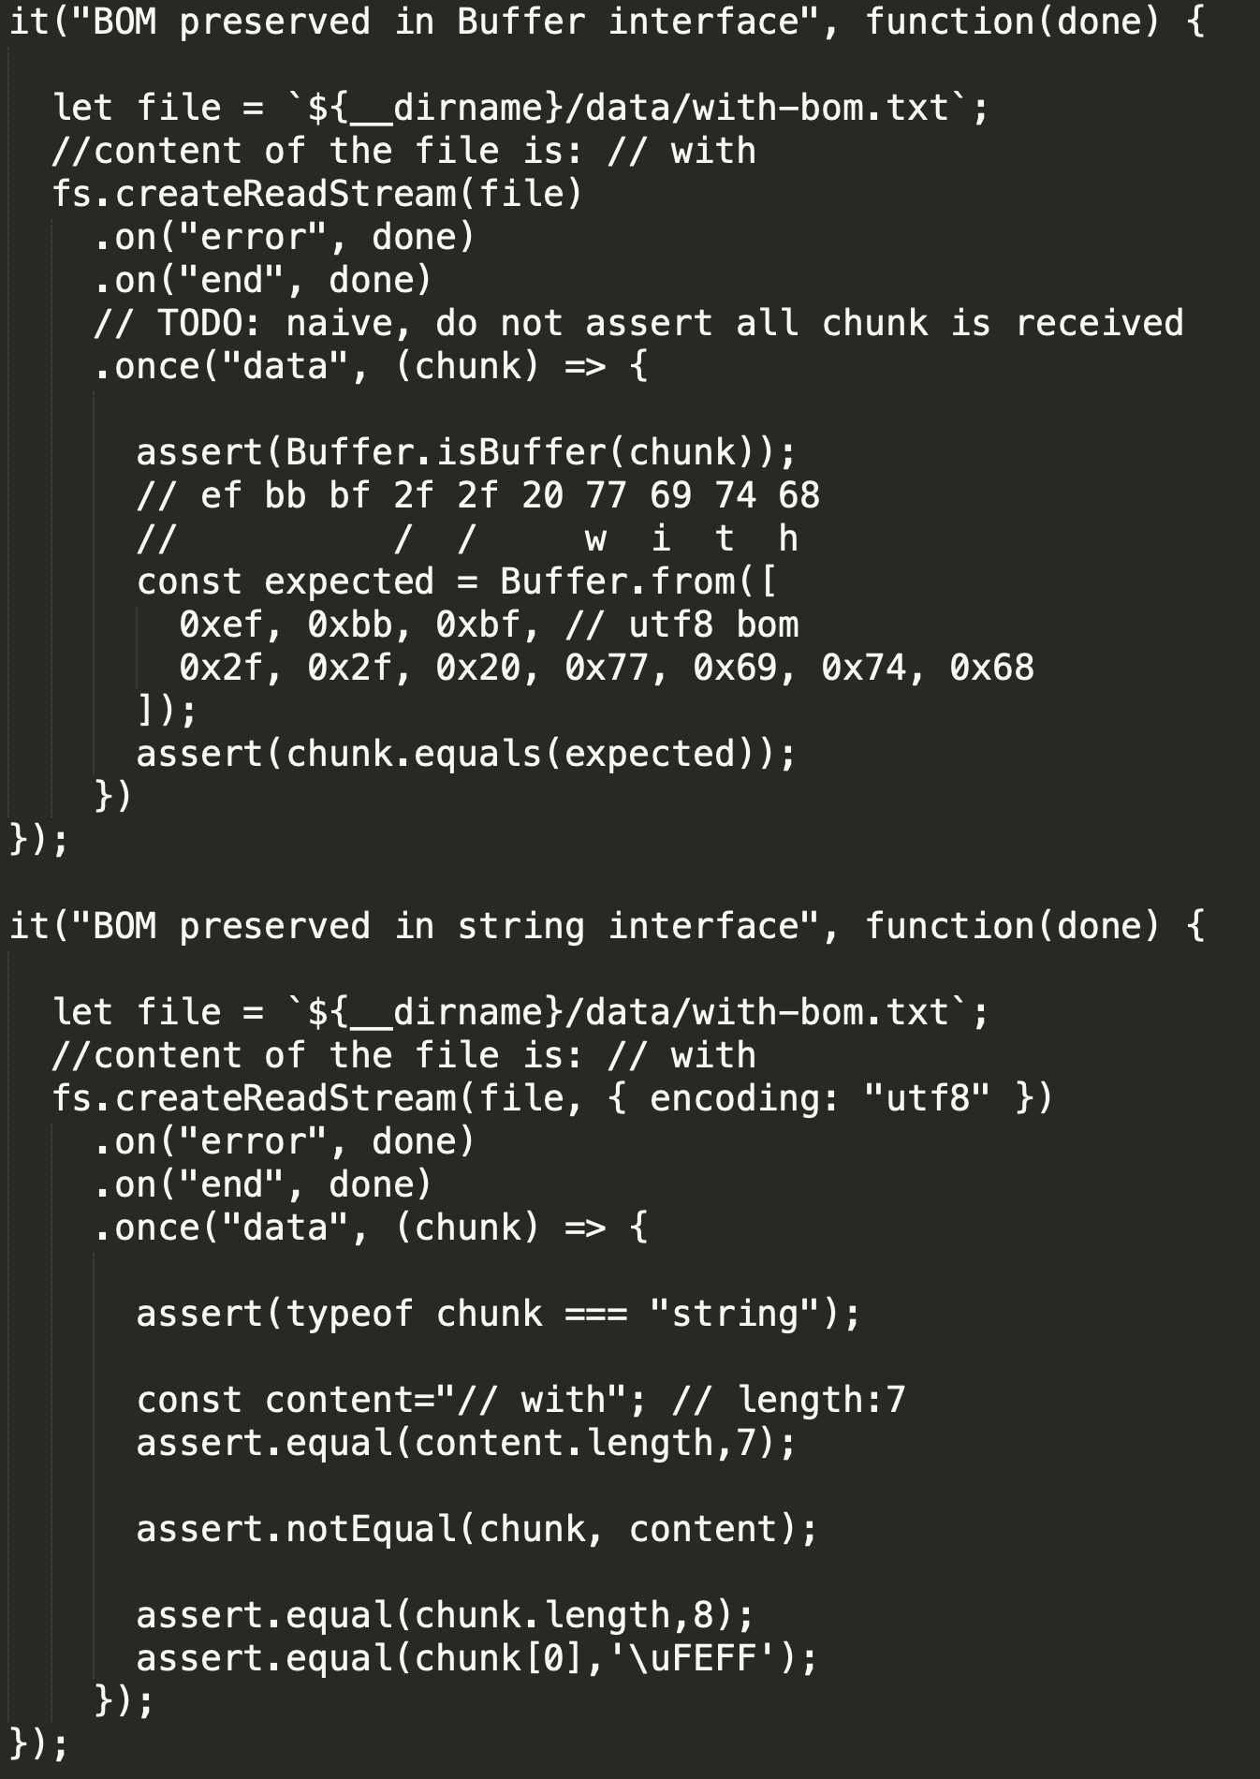
BOM problem with streams
BOM in node.js (and python) discussion: https://github.com/nodejs/node-v0.x-archive/issues/1918
In short:
BOM is not removed from buffer (expected)
BOM is not removed from string (expected ?)

Slide 5
Walkthrough
Implementation

Slide 6
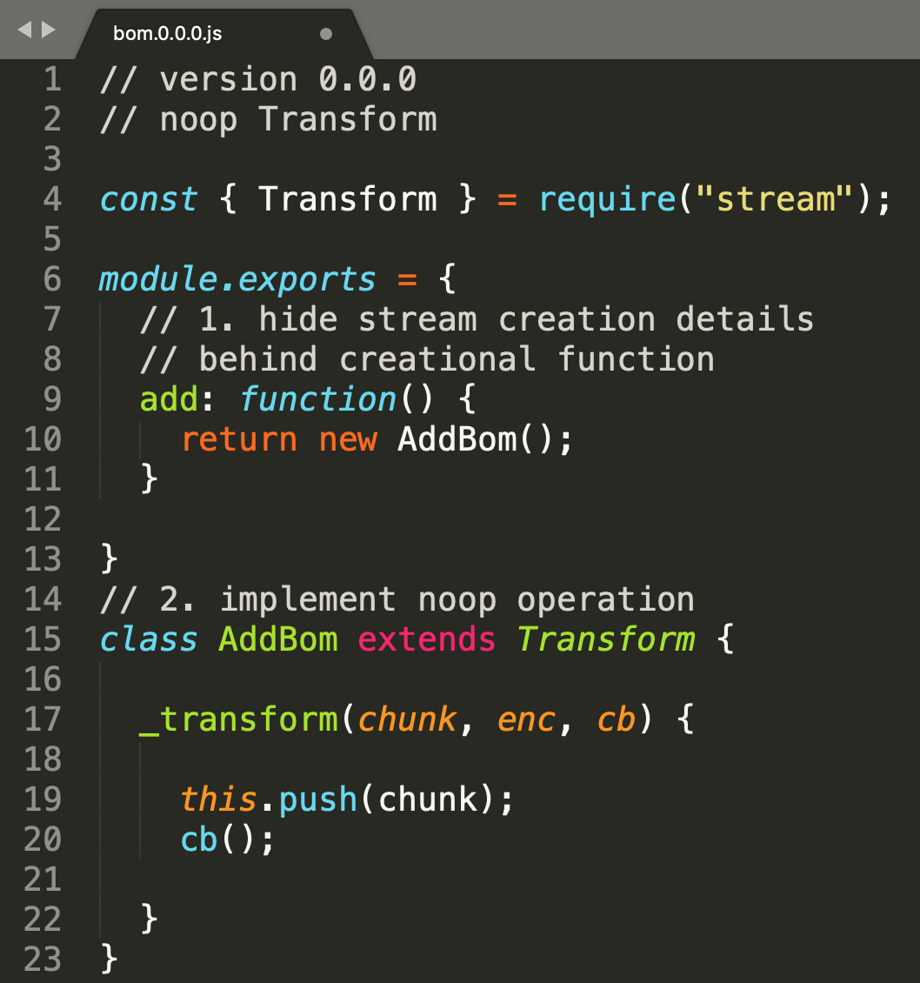
Removing BOM - as node.js Transform stream
0) new module
Export functions, not constructors
Implement NOOP Transport
_transport with push and cb()

Slide 7
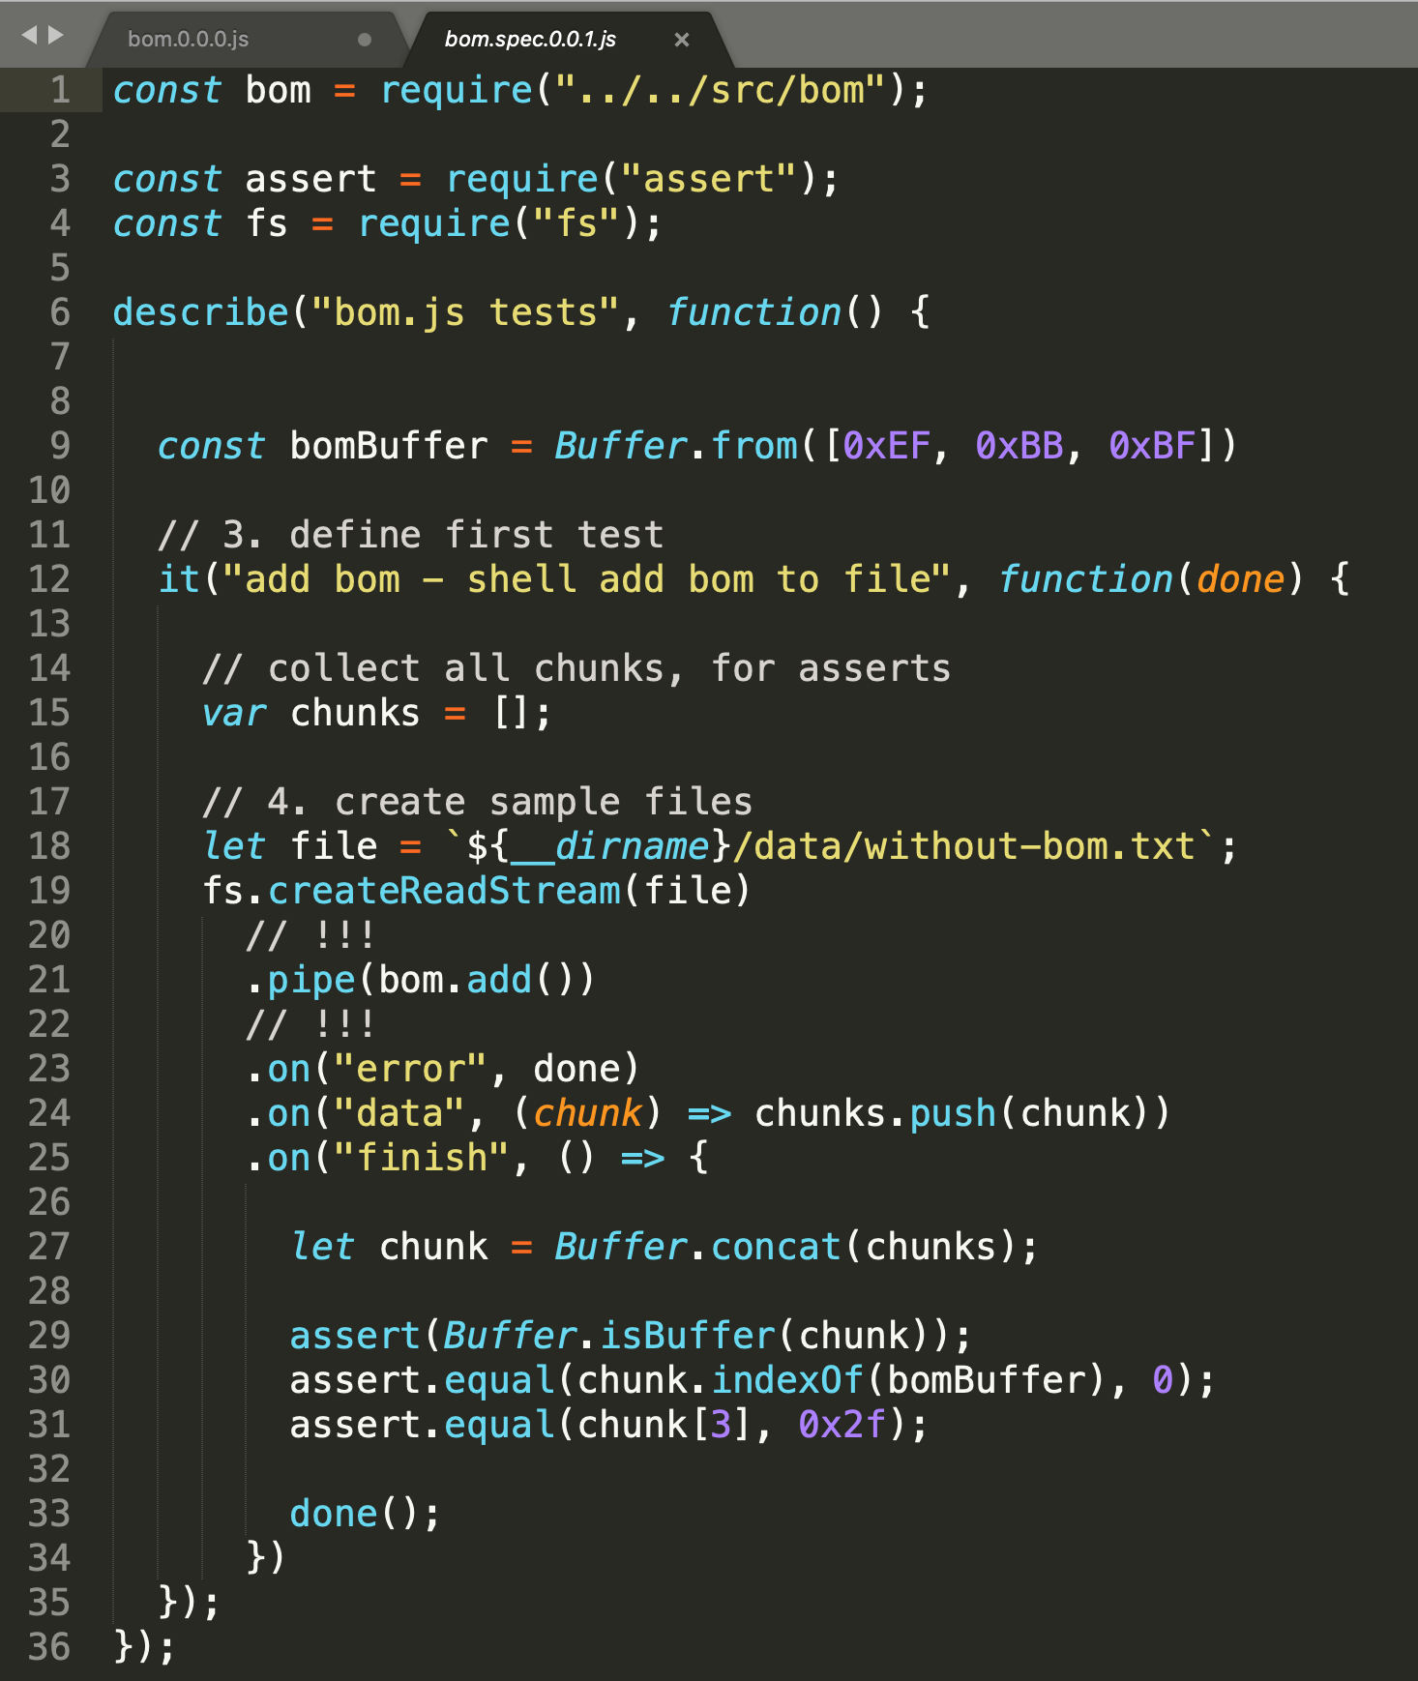
Define expected behavior as test
4) Sample files created with text editor capable to save with BOM and without BOM (Sublime used)
Read file [19]
Pipe to our library [21]
Collect all returned chunks [24],[27]
Assert returned data are
Buffer [29]
And contain leading bom sequence [30]
Followed by original file content [31]
Buffer API used:
concat
isBuffer
indexOf
buf[i]

Slide 8
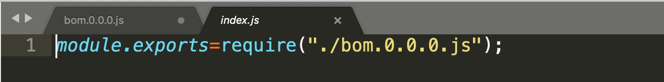
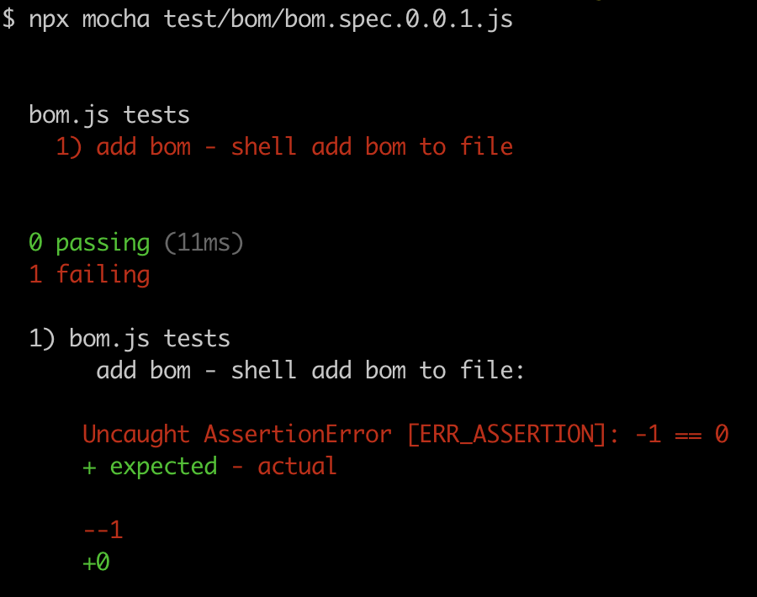
Run tests
Create indirection module bom/index.js for easier version switching (just for demo purposes in pracite you version on git), we will change versions of implementation and reference this module in tests
Run tests
Test is expected to fail with our empty Transform

Slide 9
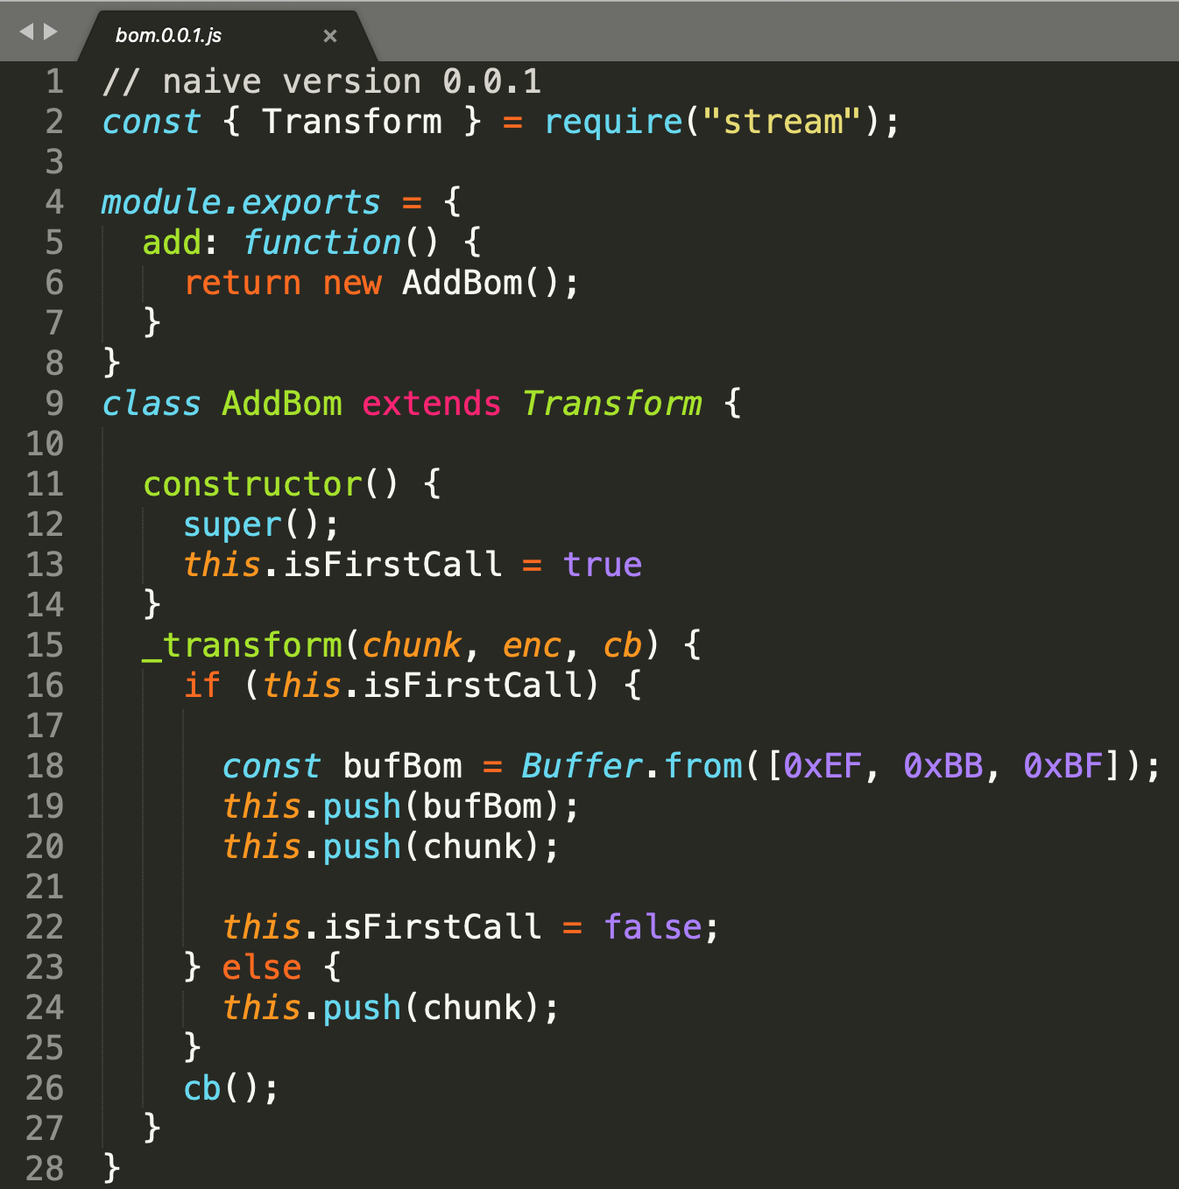
First version 0.0.1
_transform is called several times, each time data is available from source
on first call (first chunk) we want to add BOM bytes
other chunks go unmodified
Implementation:
flag [13]
push bom and data [19,20], drop down flag [22]
or push data [24]
in both cases callback [26]
API used:
transform.push can be called several times in one _transform
Buffer.from(array)
transform.constructor (defaults)

Slide 10
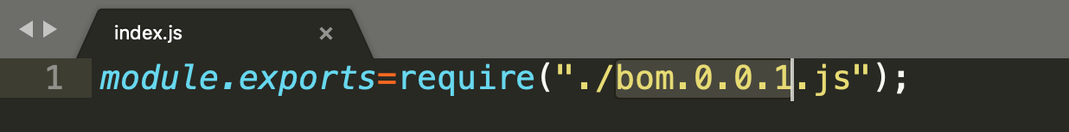
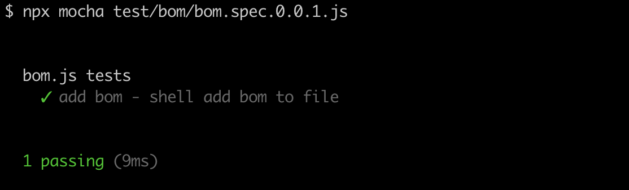
Test version 0.0.1
route implementation to newest version
run test
green
good code ? no ! bad test test ;-)))

Slide 11
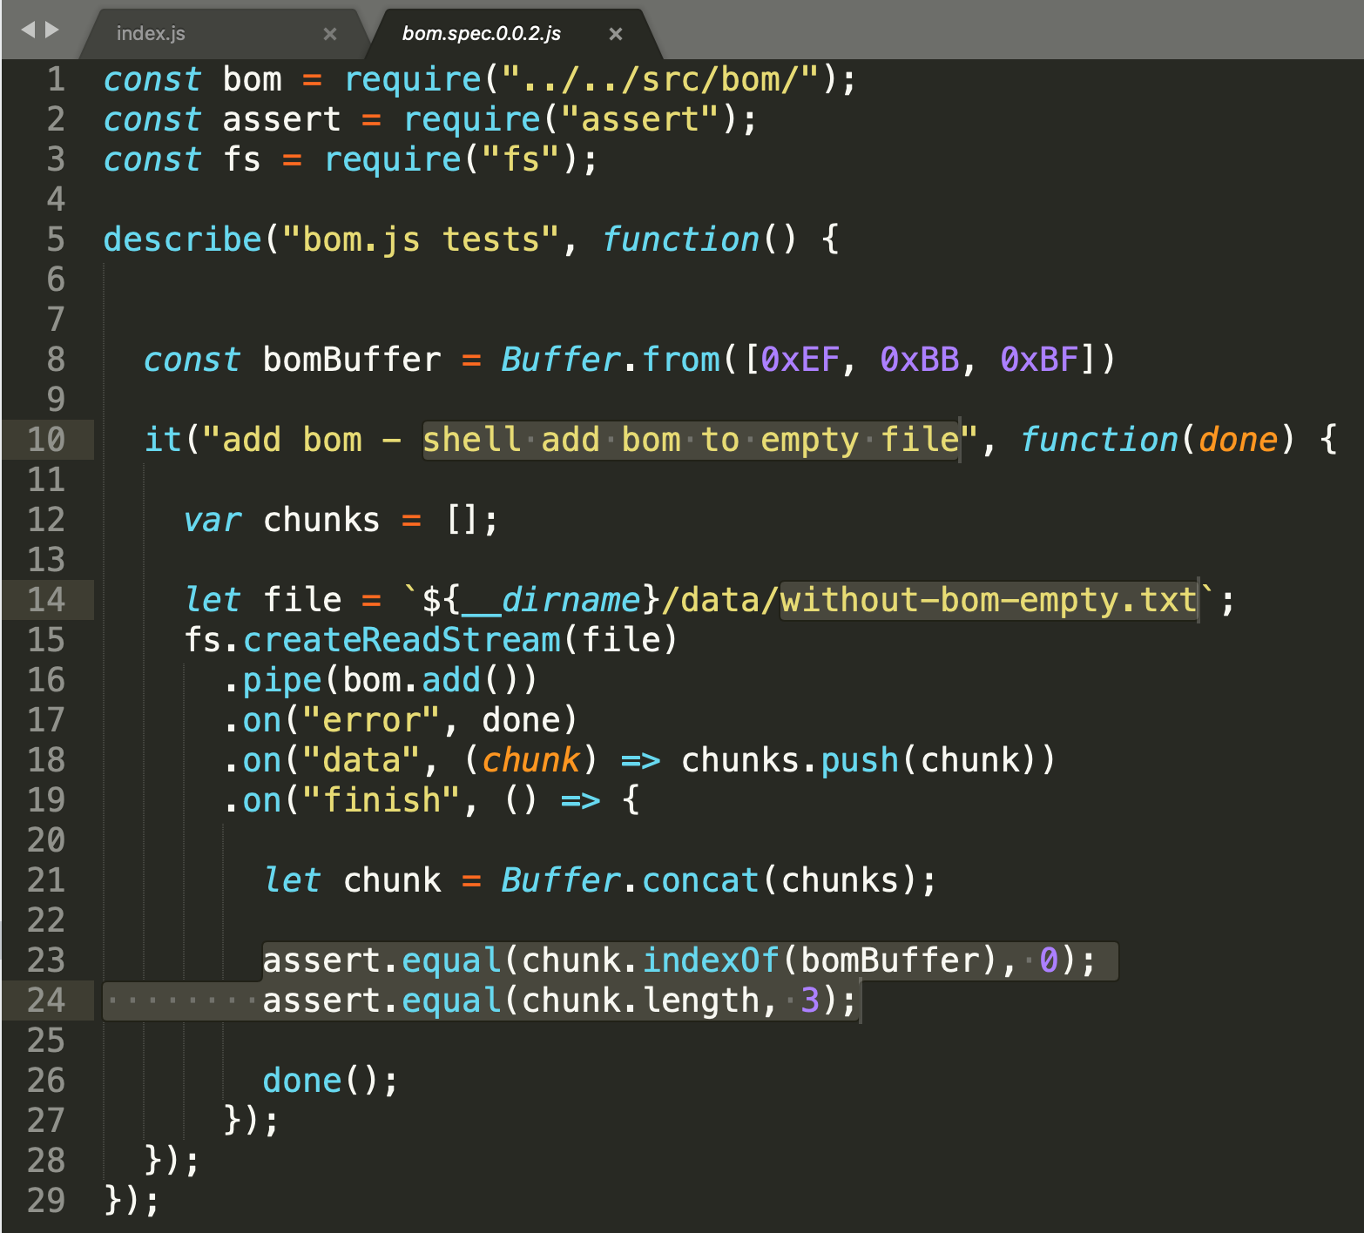
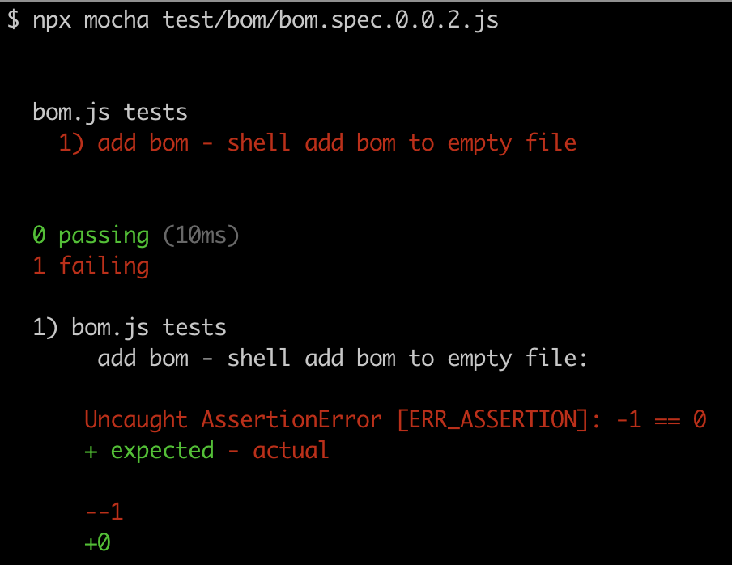

test 0.0.2 handling empty files
what if we add another test file and test for handling empty files
suppose we want BOM to be added also to empty file
create and use empty file [14]
assert final content and length [23,24]
API introduced:
buffer.length
Test fails, dont‘t forget to run previous tests as well:

Slide 12
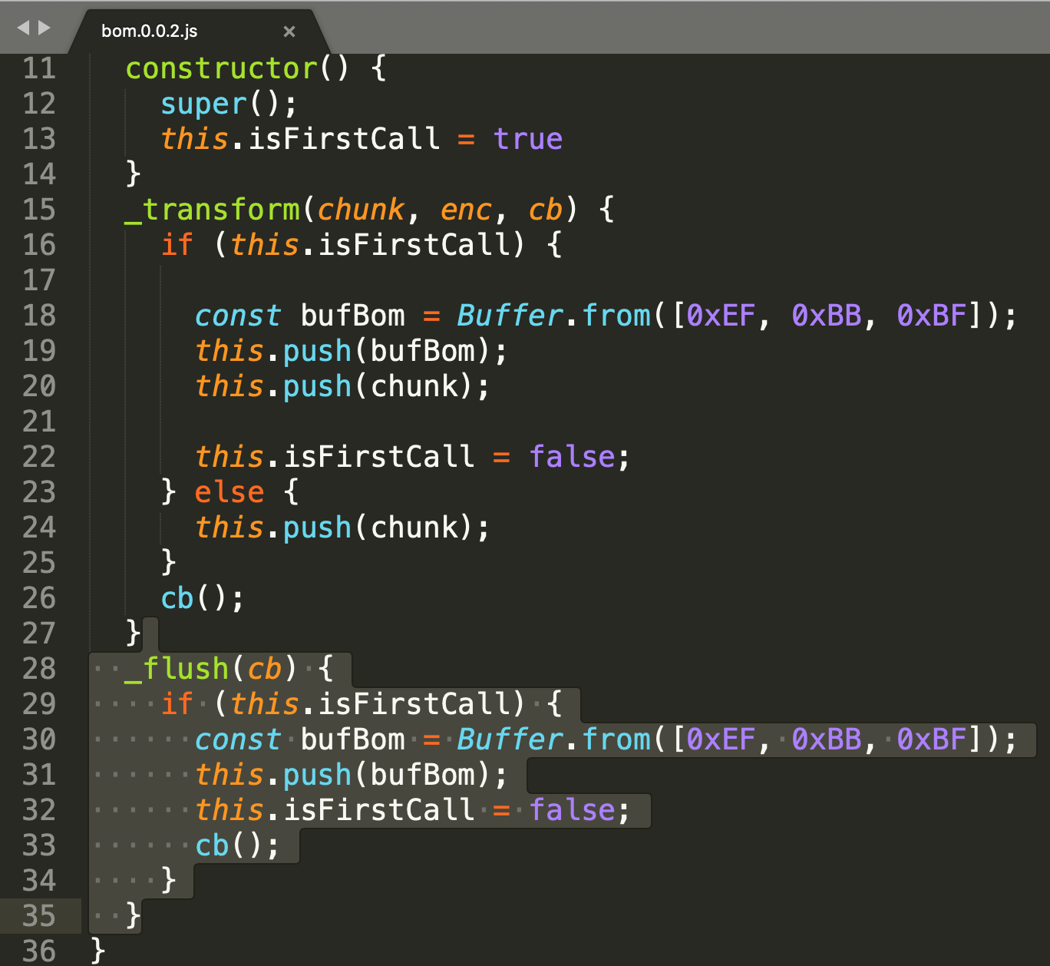
version 0.0.2
test fails, no BOM added to stream
_transform clearly not called, no data
RECAP: _flush method on transform.... In some cases, a transform operation may need to emit an additional bit of data at the end of the stream. https://nodejs.org/api/stream.html#stream_transform_flush_callback
we do not want to emit additional data we want to emit if transform did not emit anything [29].
and we emit (push) only bom [31]
drop the flag and callback [33]

Slide 13
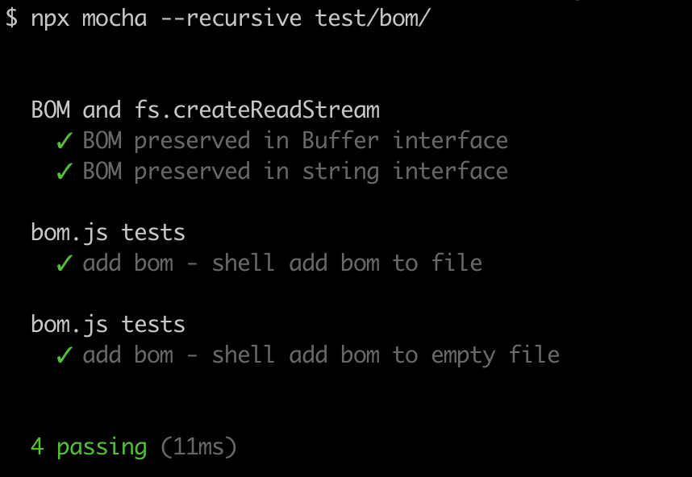
test 0.0.2
now all tests are green
good code ?
no bad tests or incomplete spec

Slide 14
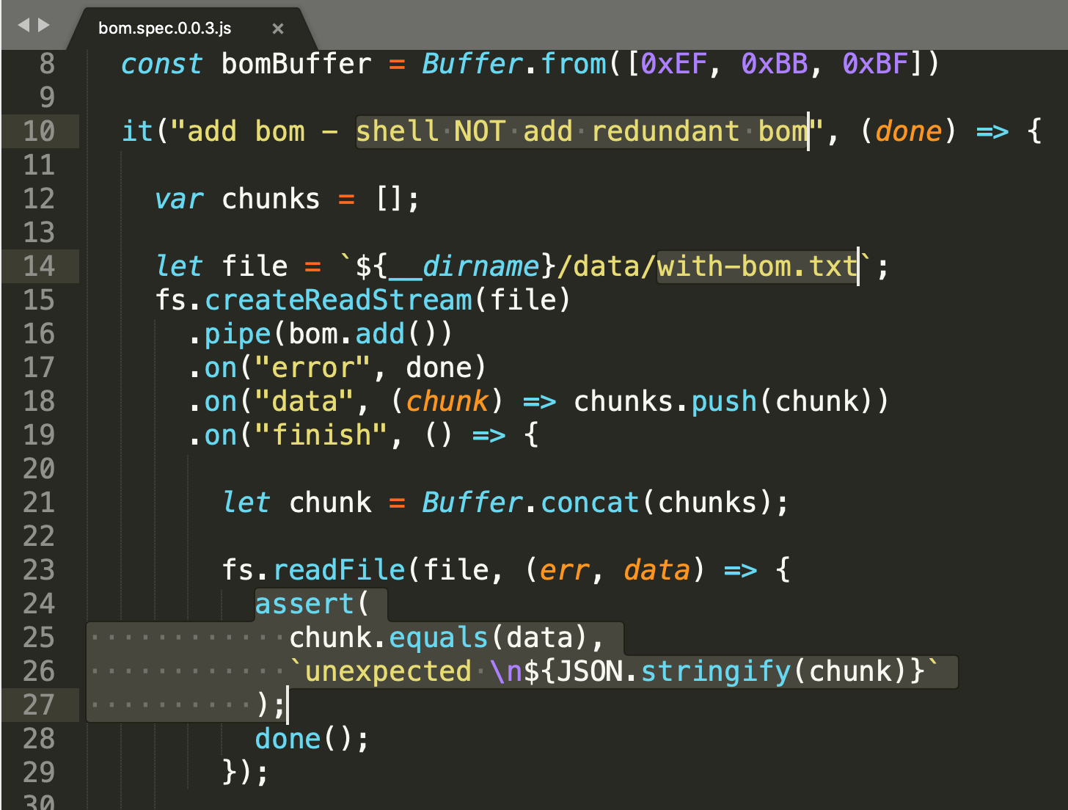
test 0.0.3
Incomplete spec:
we do not want to add BOM to stream that already has the BOM
Test:
create file with BOM (editor, or pipe bom.add() twice [14]
assert that content of returned stream is same as content of file [23-26]
API introduced:
buff.equals(buff2) [25]
buff.toJSON() (JSON.stringify(buff)) [26]
buff.toString() – not usable to print raw buff data

Slide 15
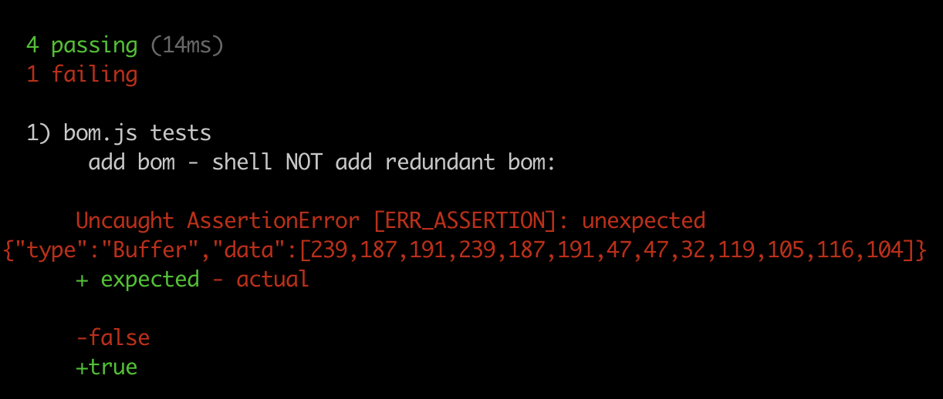
test 0.0.3 with 0.0.2 impl
test fails
from custom assert message it is clear that contents of buffer contains duplicate sequence of BOM

Slide 16
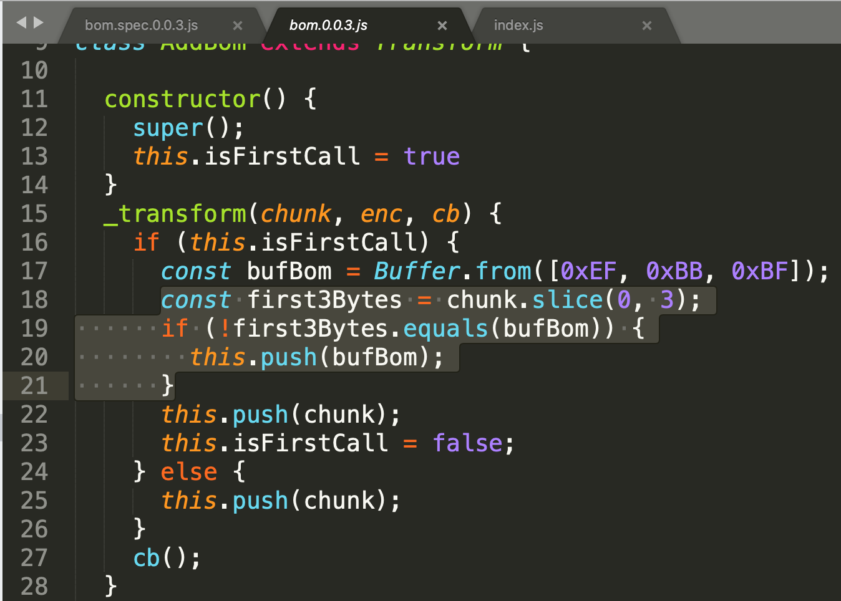
version 0.0.3
when reading first chunk:
let‘s comare first bytes with chunk [18] with bom [19] and push only when not there [20].
So it is extra 3 lines to our existing code
We do not need to fix flush

Slide 17
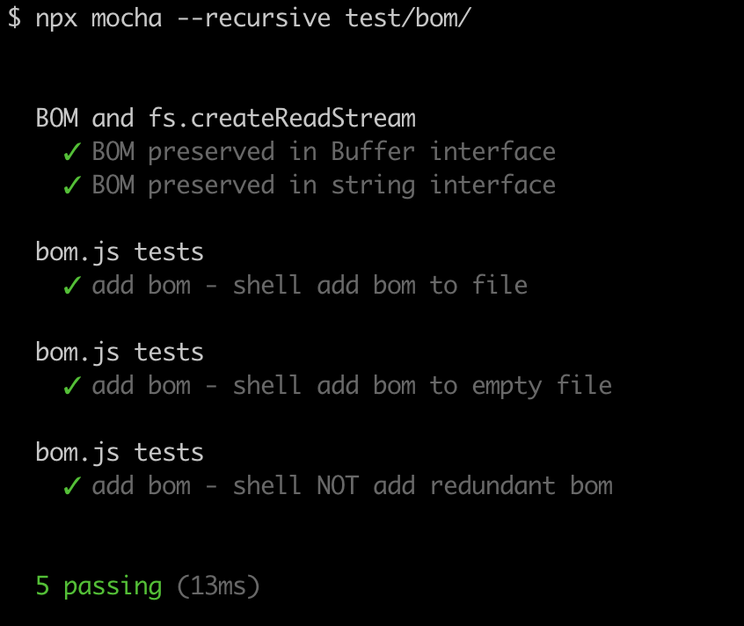
test 0.0.3
Change impl. version in index
run all tests
green
good code ?
no bad test
and bad code assumptions

Slide 18
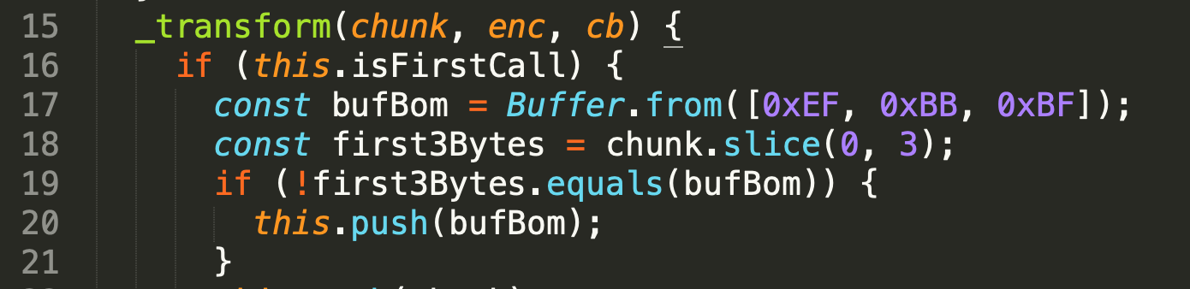
version 0.0.3 test 0.0.4
bad assumtions
chunk size in transform does not have to be 3+ in length, it is not guaranteed and transform shall not do any assumptions about chunk sizes from producer
Čo ak mi producer pošle 2 byty a potom 2 byty ?
How to write test for this ?

Slide 19
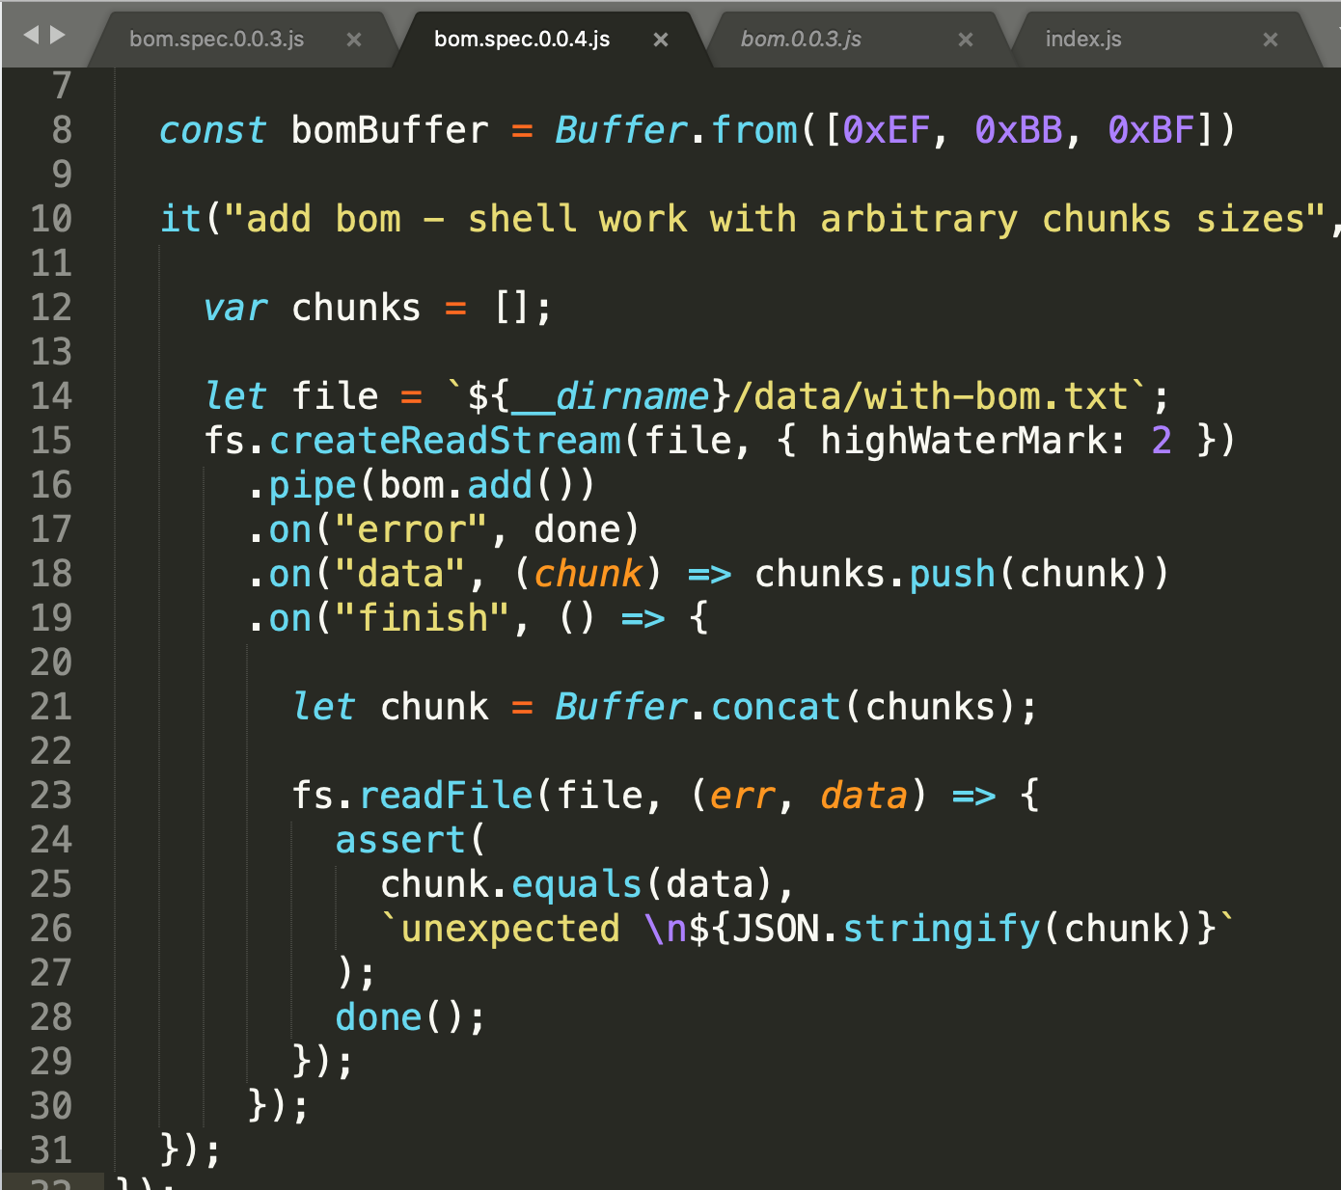
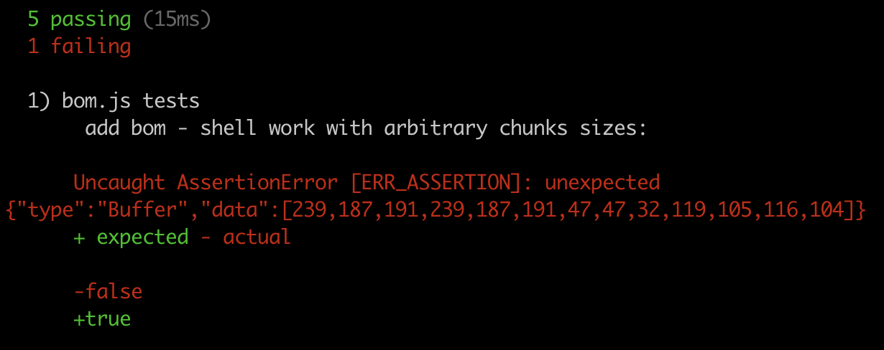
test 0.0.4
to create test for arbitrary sizes, just modify 0.0.3 test and set highWaterMark (buffer size) on Readable (producer) [15].
This will cause producer to emit data to Translate and calling _translate with 2 bytes chunk, and to fail the check for already existing BOM

Slide 20
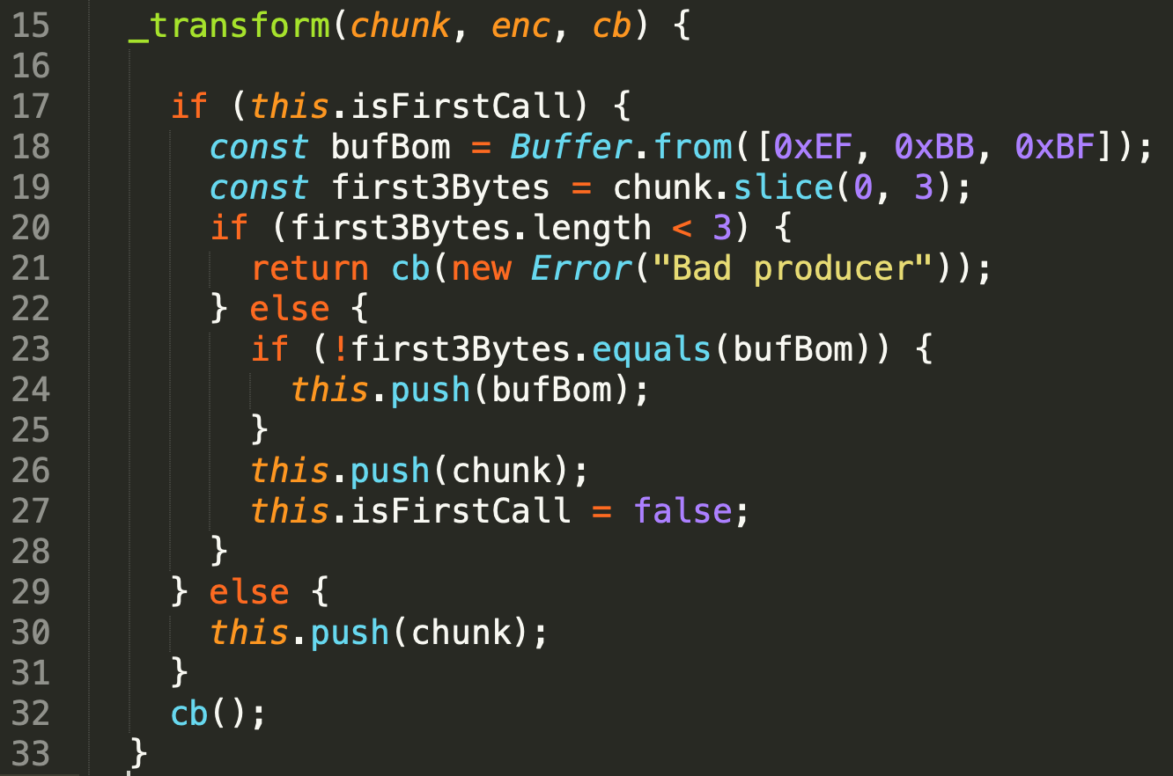
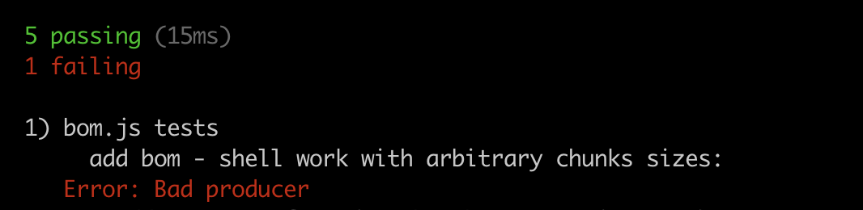
version 0.0.4
First refactor – let‘s isolate problematic situation with if, else
slice –with bigger end returns buffer of real size, so slice(0,3) will not fail but return new buffer with size 3, or 2 or 1 [19]
for case of < 3 we must make new code [20]
in case of 3 (normal we can continue the original code branch) [22-27]
for now the new code will report unsupported operation and fail [21]
callback must be guarder wioth return to avoid duplicit callbacks [21]
Even this is big improvement, failing instead of producing incorrect data (double BOM)

Slide 21
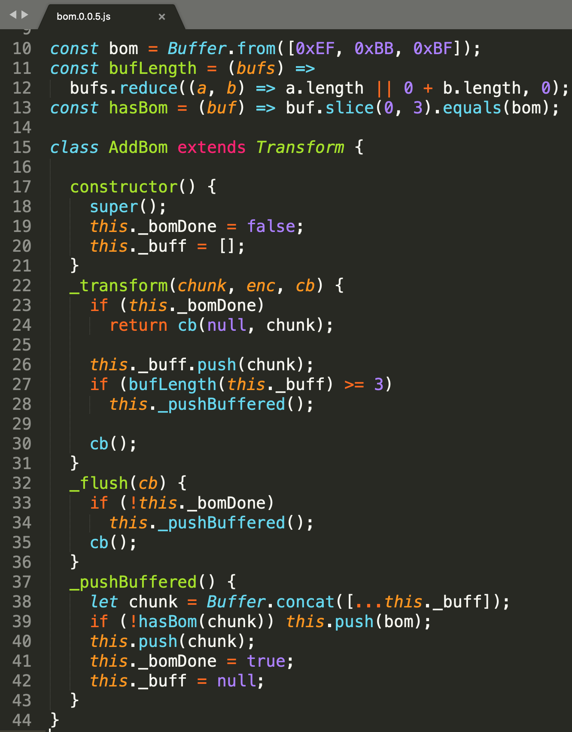
version 0.0.5 complete rewrite
until we have at least 3 bytes, we need to buffer chunks internally [20,26] for example as array of Buffers, and do not push(), just call cb() [30].
Once we have 3 bytes and more buffered [27,11,12] we can decide if bom shall or shall not be written [39,13] and we must send all previously buffered data [40,38]
Line 26 pushes data to internal buffer before chceking, to be able to flush in the same _transform call if with this chunk we have enough
line 42 is cleanup of allocated internal array of buffers, so array and buffers can be garbage collected

Slide 22
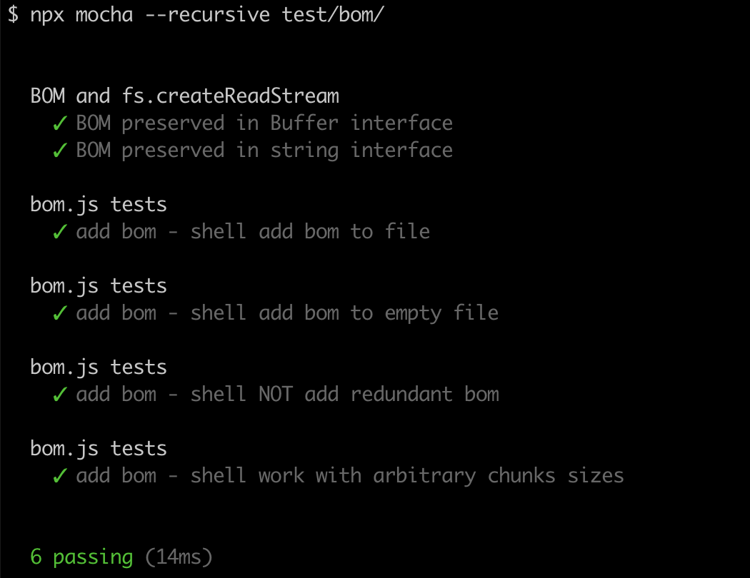
test of 0.0.5
with tests in place:
we have confidence to rewrite and refactor
to be sure we have not broken previously working functionality
is the code ok ? or is it just
incomplete test
incomplete spec
wrong assumptions

Slide 23
not done yet ……
is the code ok ? or is it just
incomplete test
incomplete spec
wrong assumptions

Slide 24
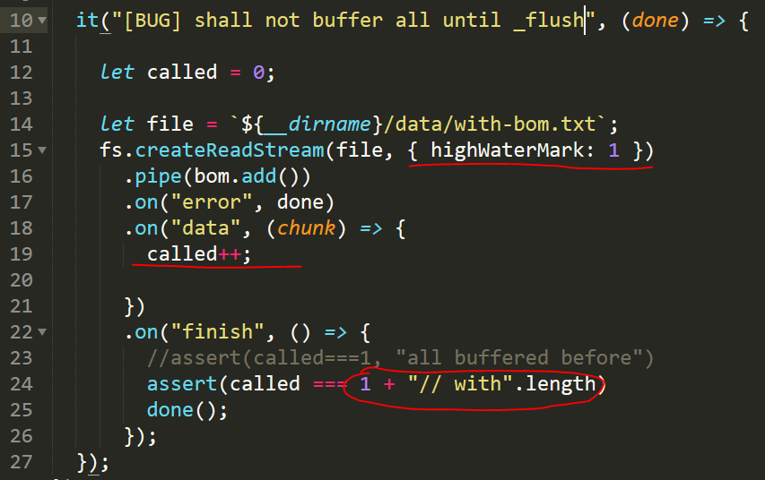
test of 0.0.6, fix 0.0.6
Codereview (by students) revealed incorrect sum implementation of buffer length [11,12]
However all “works” (by accident) because _flush saves the day
How to write test probing the bug
a) extract bufLength to module and write test
b) but how to add test prooving chunks are emited by transform and not only by _flush

Slide 25
Excercises
homework

Slide 26
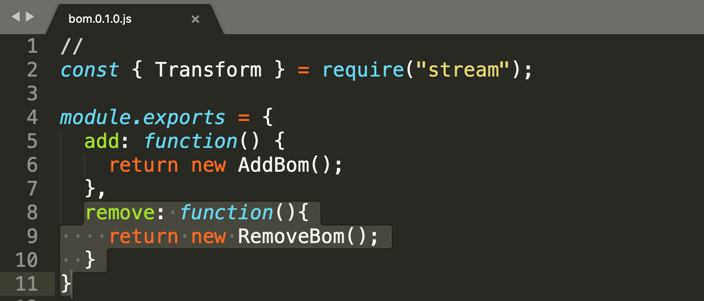
remove bom
After having implementation for bom.add(), try to implement bom.remove(), follow pitfalls from add implementation to avoid same errors in remove code
test on:
files/streams with bom
without bom
test with encoding specified
...
implement tests, at least as bad as for add bom

Slide 27
add bom
TODO:
more universal tests, find bugs,
rewrite
to nicer code
more understandable for you code
optimization
buf.concat....

Slide 28
solutions
userland

Slide 29
Userland solutions
https://github.com/sindresorhus/strip-bom-stream
TODO: review and study the code, compare with your solution
TODO: find and review other similar codes

